Slide 1
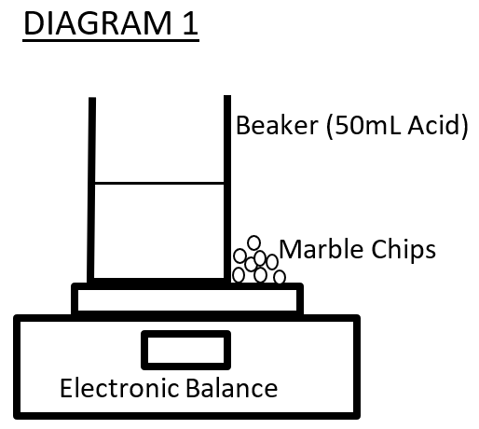
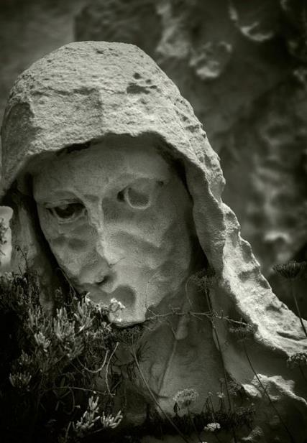
Acid rain and Calcium Carbonate structures
Group Members:
Billy the Kid; Superman; Bilbo Baggins; Albert Einstein
100 mL beaker electronic scales Container of marble chips Sulphuric acid (1.0M) 25 mL Measuring Cylinder Distilled water Watch or timer
Method
Equipment and Materials:
INITIAL: How does acid rain affect statues and building made of limestone? (this is the one given in the assignment sheet)
FINAL: Does the concentration of sulphuric acid affect rate of the reaction with calcium carbonate. (this is “designed” (restructured) but not enhanced)
1. Measure 50 mL of sulphuric acid (1.0M) and pour into the beaker.
2. Place the beaker on the electronic scales as shown in Diagram 1 (below).
3. On the electronic scales, beside the beaker add exactly 4 grams of marble chips.
4. Tare (zero) the scales so that the reading is 0.00 g
5. Pick up the Marble chips and add them (all together) to the beaker of Acid. Start the timer at this point.
6. Stir the solution.
7. At the three-minute mark record the loss in mass of the acid and Marble Chip mixture
8. Repeat steps 1-7 but using different concentrations of Acid
Research Question:
Independent variable:
Concentration of Sulphuric acid
Dependent variable:
Mass loss of the reaction mixture
Variables:
Risk Assessment
Table 1: Assessment of risks faced in this experiment
As the concentration of the acid increases so does the loss in mass. This means that as the concentration of the acid rain increases more calcium carbonate is lost. At a concentration of 0.4M, the mass loss was 0.19g. At double this concentration (0.8M) the mass loss was 0.38g. This shows that the mass loss was greater at the higher concentrations of acid.
This data shows that acid rain affects Calcium carbonate structures by dissolving them. The more acid rain the more the structures dissolve.
Source of risk | What amount of harm could it cause? | Safety precautions taken | If an incident occurred what should I do?
Sulphuric Acid | Major Injury to eyes and skin | Incomplete or lacks clarity | okay
Marble Chips (calcium Carbonate) | Minor Possible cuts from edges | okay | Incomplete or lacks clarity
ANALYSIS
Results
Concentration of Sulphuric Acid | Mass loss after 3 minutes
 | Trial 1 | Trial 2 | Trial 3 | Average
1 M | 0.56g | 0.53g | 0.58g | 0.56g
0.8 M | 0.36g | 0.37g | 0.41g | 0.38g
0.6 M | 0.25g | 0.11g* | 0.21g | 0.23g
0.5 M | 0.18g | 0.19g | 0.18g | 0.18g
0.4 M | 0.19g | 0.2g | 0.19g | 0.19g
Graph of results:
Conclusion
Higher concentrations of acid rain cause greater mass loss when it reacts with marble. This shows that increased pollution, and higher concentration of acid rain, will cause an increased loss of mass from Calcium carbonate structures. It also shows that lower concentrations of acid rain will cause less mass to be lost from the

